Slide 1
Object Oriented Analysis and Design
Activity Diagrams

Slide 2
Activity Diagrams
Activity diagrams are graphical representations of workflows as stepwise activities

Slide 3
Activity Diagrams
Activity diagrams are the object-oriented equivalent of flow charts and data-flow diagrams from structured development.
Activity diagrams describe the workflow behavior of a system
The process flows in the system are captured in the activity diagram.
Activity diagram illustrates the dynamic nature of a system by modeling the flow of control from activity to activity.

Slide 4
Activity Diagrams Represents
A complex operation
A complex business rule
A single use case
Several use cases
A business process
Software processes

Slide 5
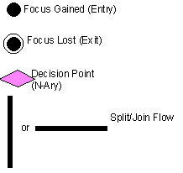

Symbols

Slide 6
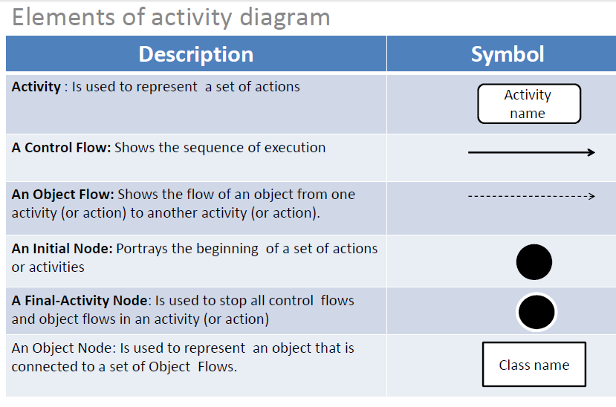

Slide 7
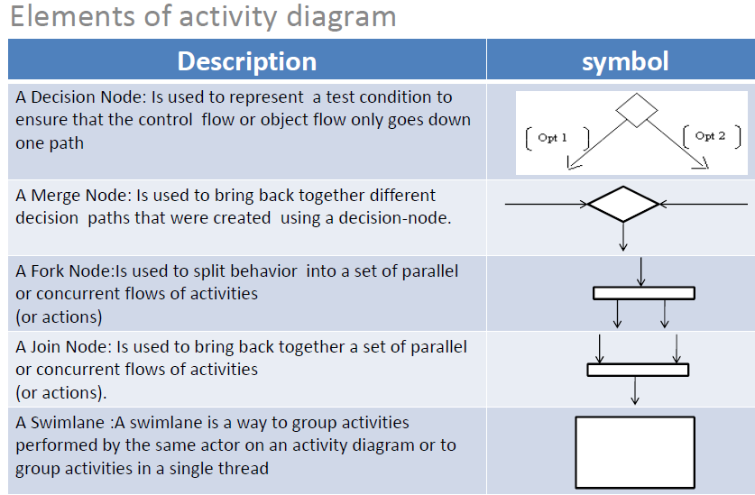

Slide 8
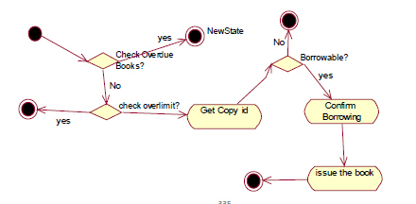
Start of the diagram
Guided condition
Decision point
Activity
Final state

Slide 9
Example - 1
creating document
Open the word processing package
Create a file
Save the file under a unique name within its directory
Type the document
If graphics are necessary, open the graphics package, create the graphics, and paste the graphics into the Document
If a spreadsheet is necessary, open the spreadsheet package, create the spreadsheet, and paste the spreadsheet into the document
Save the file
Print a hard copy of the document
Exit the word processing package

Slide 10
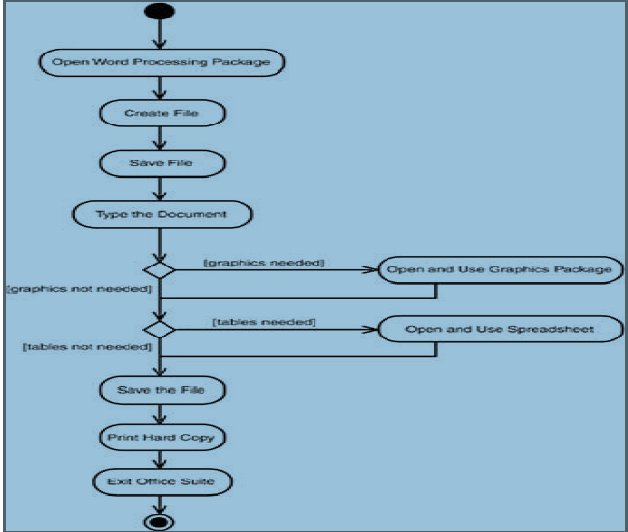

Slide 11
Example 2
Once the order is received the activities split into two parallel sets of activities. One side fills and sends the order while the other handles the billing. On the fill order side, the method of delivery is decided conditionally. Depending on the condition either the overnight delivery activity or the regular delivery activity is performed. Finally the parallel activities combine to close the order.

Slide 12
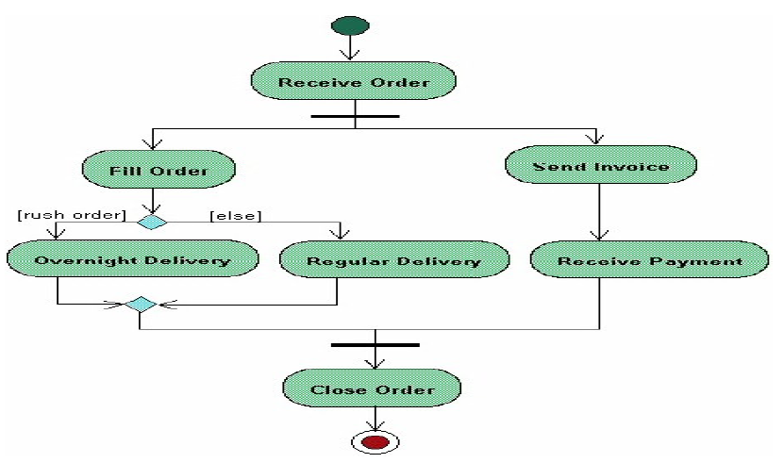

Slide 13
Enrollment in university
An applicant wants to enroll in the university.
The applicant hands a filled out university application form to the registrar.
The registrar inspects the forms.
The registrar determines that the forms have been filled out properly.
The registrar informs student to attend in university overview presentation.
The registrar helps the students to enroll in seminars.
The registrar asks the student to pay the initial.

Slide 14
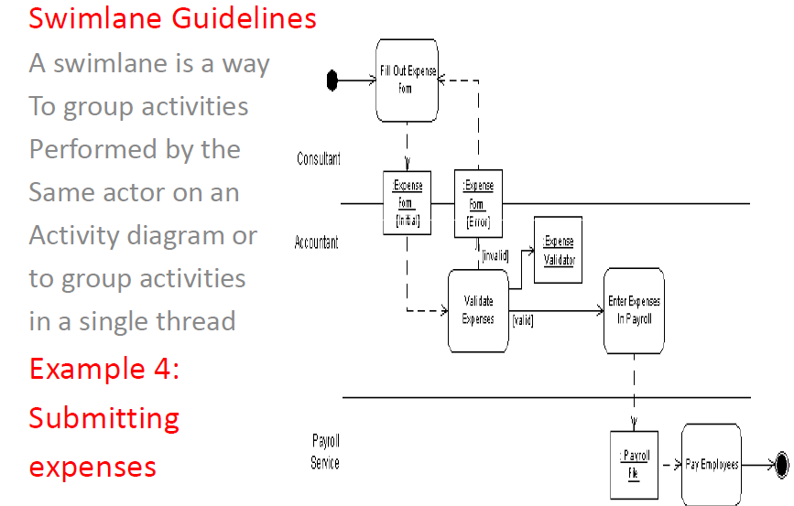

Slide 15
Business process of meeting a new client
A salesperson calls the client and sets up an appointment.
If the appointment is onsite ( in the consulting firm’s office), corporate technicians prepare conference room for a presentation.
If the appointment is offsite (at the client’s office), a consultant prepares a presentation on a laptop.
The consultant and the salesperson meet with the client at the agreed-upon location and time.
The salesperson follows up with a letter.
If the meeting has resulted in a statement of a problem, the consultant create a proposal and sends it to the client.

Slide 16
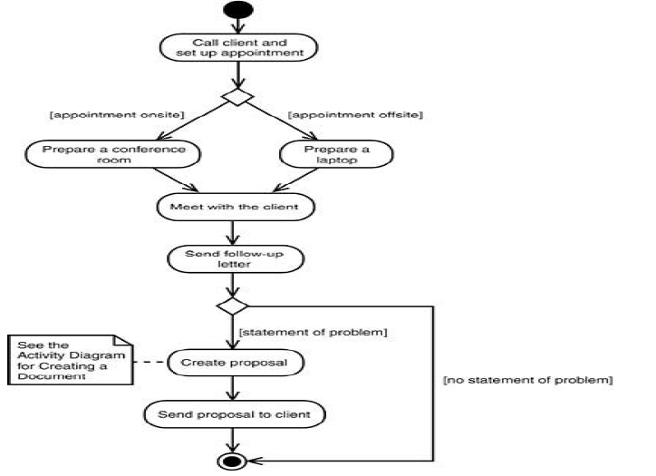

Slide 17
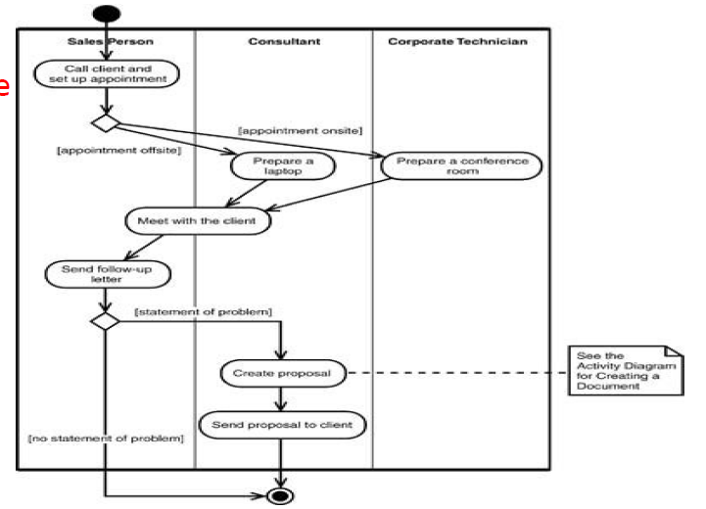

Slide 18
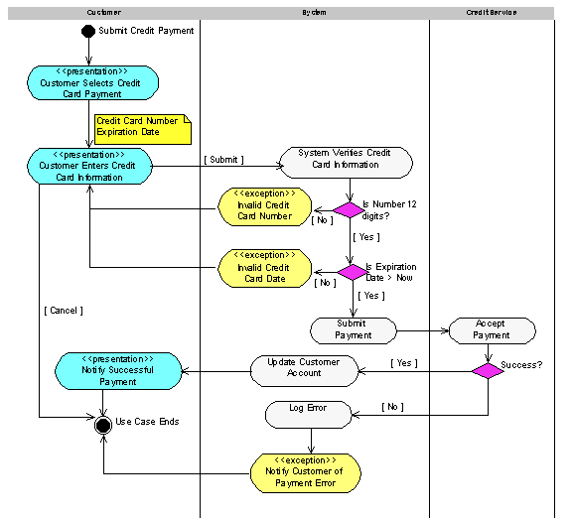
credit Card Payment

Slide 19
